Slide 1


Its flu season

Slide 2
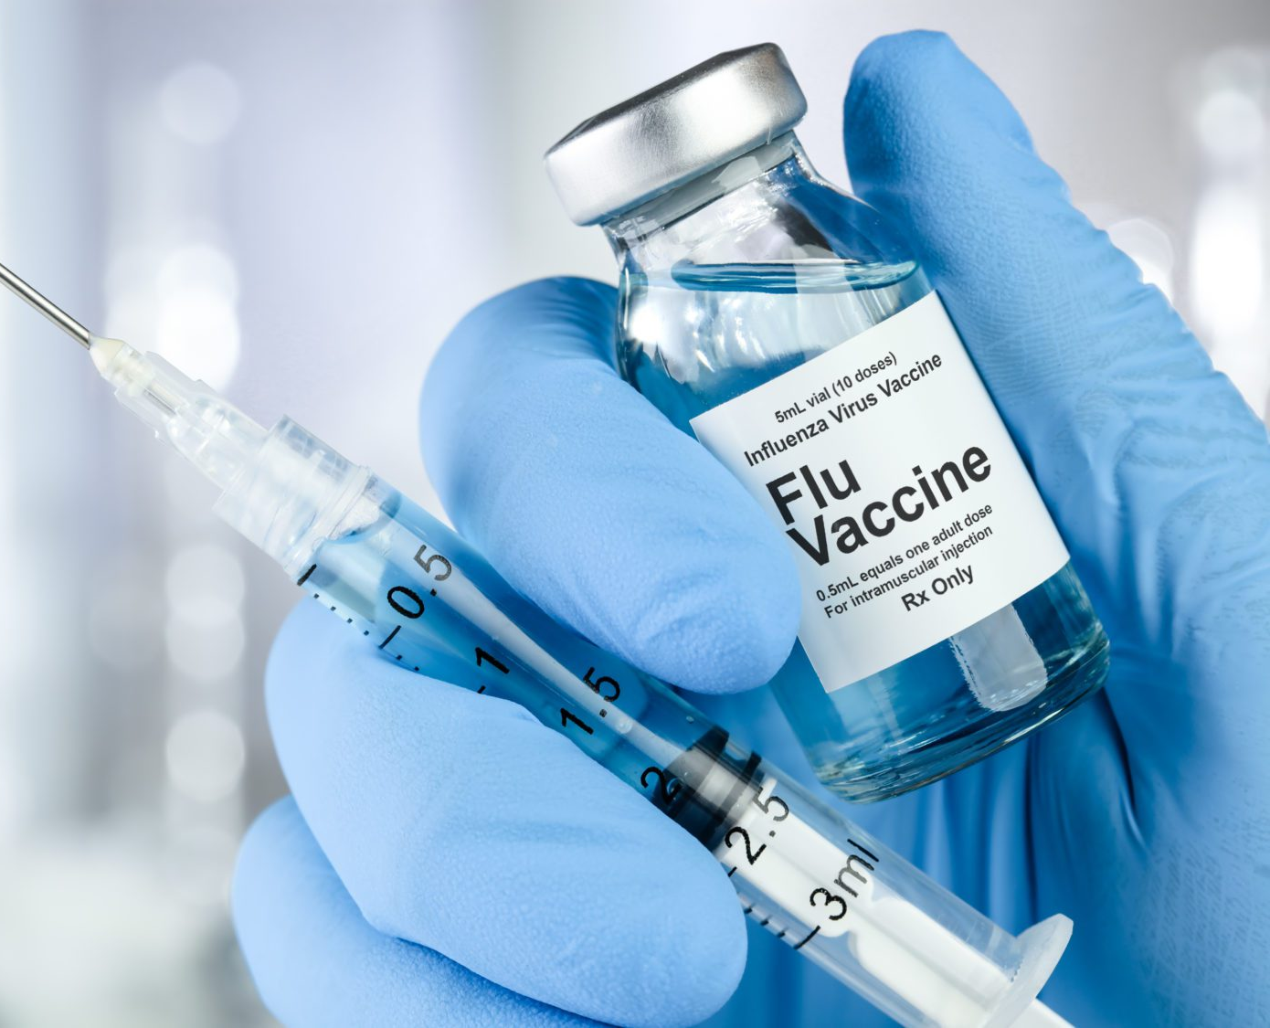

Get shot

